Slide 1
Behavioral Economics in Everyday Life: Consumption, Addiction, Environmental Protection, and Retail Therapy
Dr.R.Gayathri
Faculty,SoM SASTRA

Slide 2
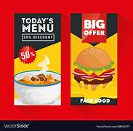
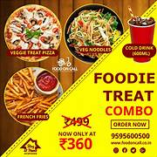
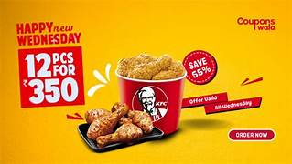
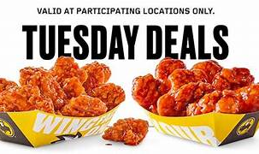
Behavioral Economics and Consumption Patterns

Slide 3
Behavioral Economics and Consumption Patterns
Present Bias: Preference for immediate gratification over long-term benefits.
Hyperbolic Discounting: Overvaluing short-term pleasure (e.g., fast food, social media).
Mental Accounting: Categorizing spending irrationally (e.g., "fun money" for shopping).
Example: People spend more with credit cards than cash due to lower 'pain of payment'.

Slide 4
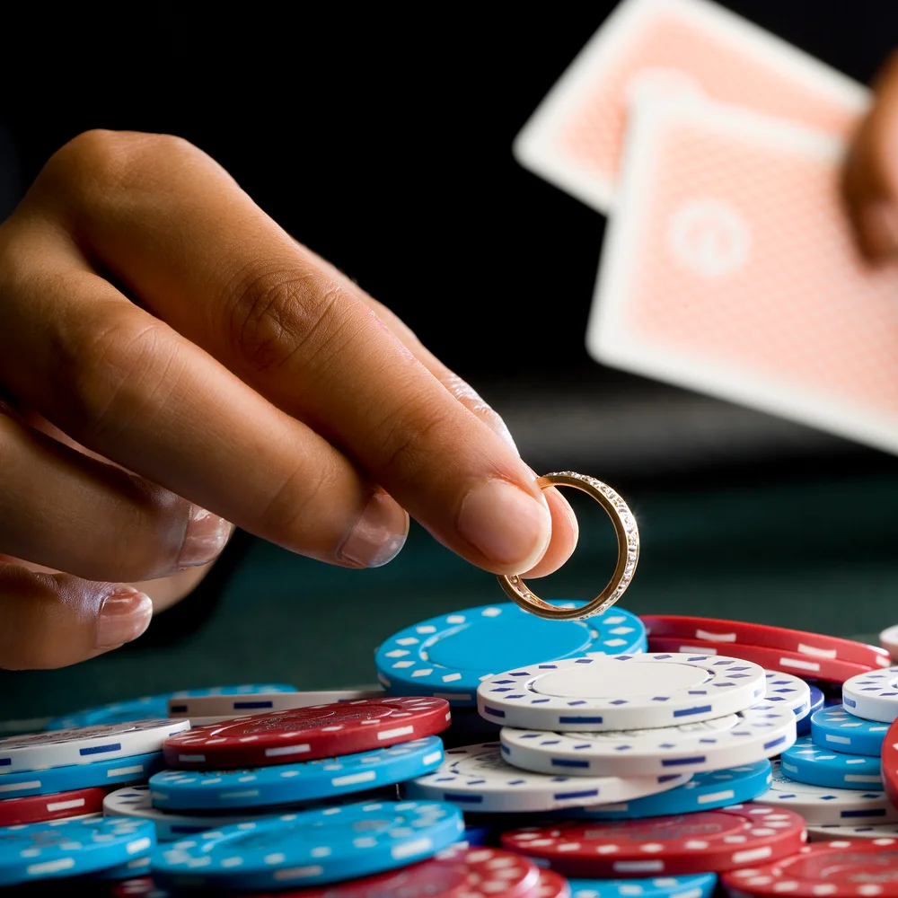
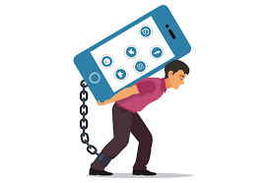
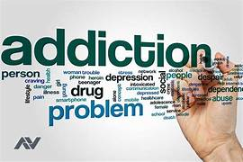
Addiction and Behavioral Economics

Slide 5

Addiction and Behavioral Economics
Loss Aversion: Fear of quitting outweighs benefits of stopping.
Intermittent Rewards: Gambling and social media exploit random rewards to keep users engaged.
Self-Control Issues: Addiction persists despite long-term harm.
Example :Casino loyalty programs: Keep gamblers engaged using small intermittent rewards. Cigarette tax policies: Higher prices reduce smoking rates.

Slide 6
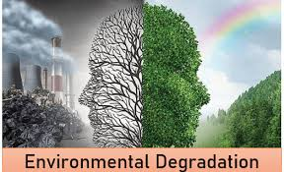

Environmental Protection

Slide 7
Environmental Protection
Default Bias: People stick to default options (e.g., auto-enrollment in green energy).Social Norms Influence: More likely to act sustainably if peers do.
Framing Effects: "Protecting nature" vs. "Preventing harm" changes behavior.
Example: Hotels using "Most guests reuse towels" message increased towel reuse by 26%.

Slide 8
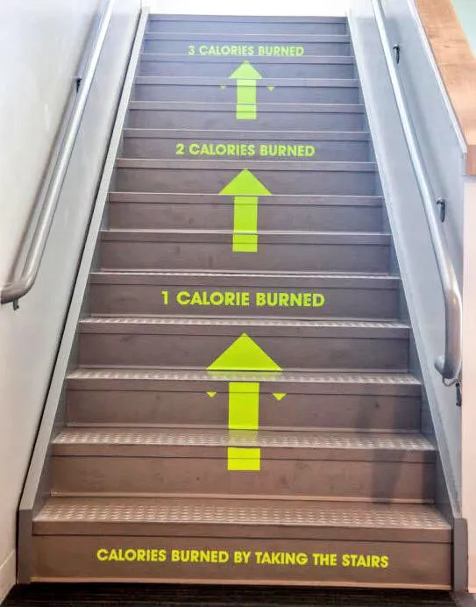
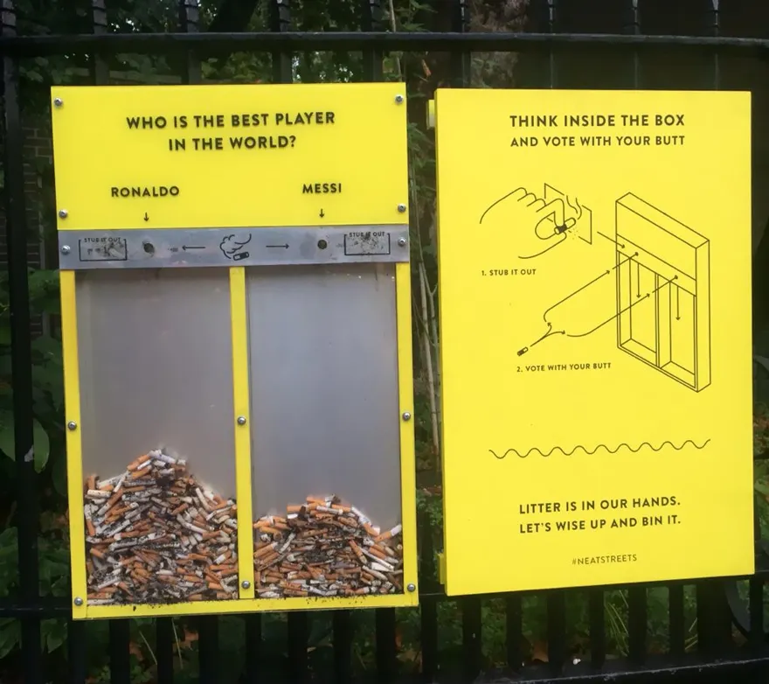
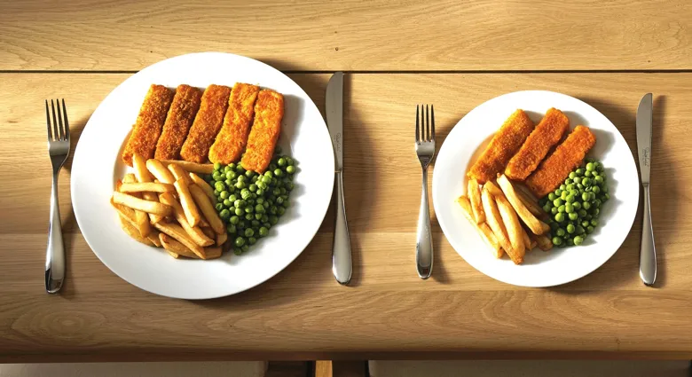
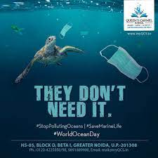
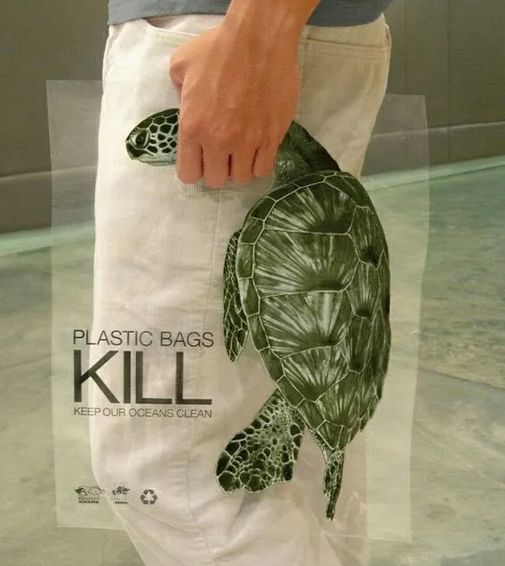
Nudging for Environmental Action

Slide 9

Nudging for Environmental Action
Green Nudges: Small changes to encourage eco-friendly behavior.
Gamification: Apps rewarding sustainable choices.
Monetary Incentives: Carbon taxes, recycling refunds.
Example: Plastic bag fees reduced usage in the UK by 85% in 6 months.

Slide 10
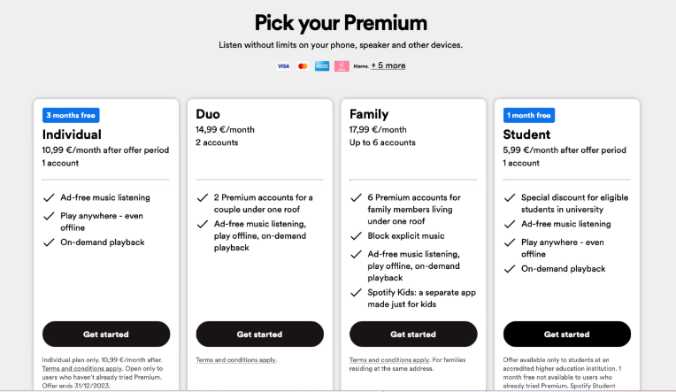
Decoy effect as a Pricing strategy

Slide 11
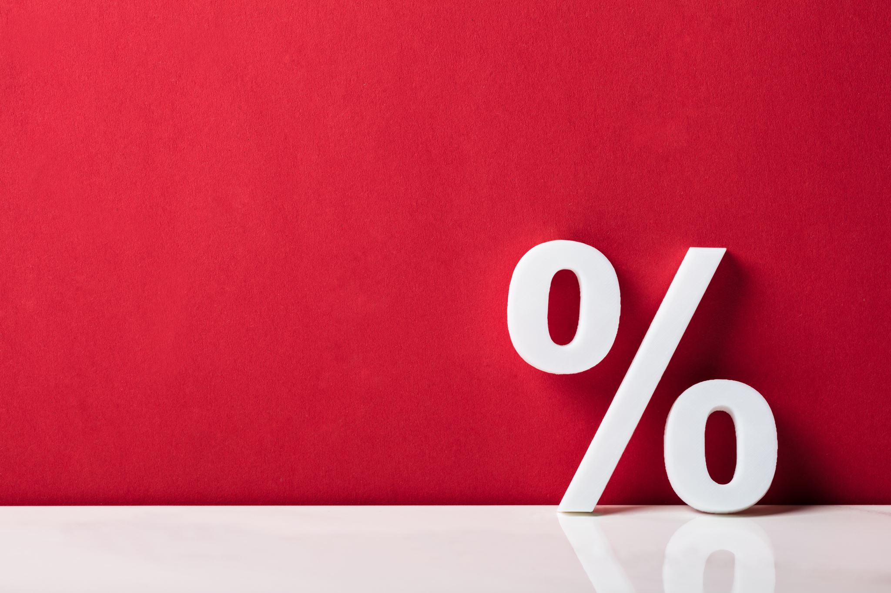
Pricing Strategies & Consumer Behavior
Decoy Effect: Adding an irrelevant option influences choice.
Scarcity Effect: 'Limited Stock' creates urgency.
Bundling & Discounts: Encourages over-purchasing.
Example: BOGO (buy one get one) deals often increase overall spending.

Slide 12

Behavioral Policies for Better Decisions
Commitment Devices: Apps restricting social media or spending.
Transparency in Pricing: Prevent misleading discounts.
Regulations on Addiction Marketing: Ban certain gambling ads.
Example: Health warnings on cigarette packs have reduced smoking rates globally.

Slide 13
Conclusion
Behavioral Economics explains irrational choices.
Nudges, policies, and awareness can improve decision-making.
Businesses & governments can apply these insights ethically.

